Slide 1
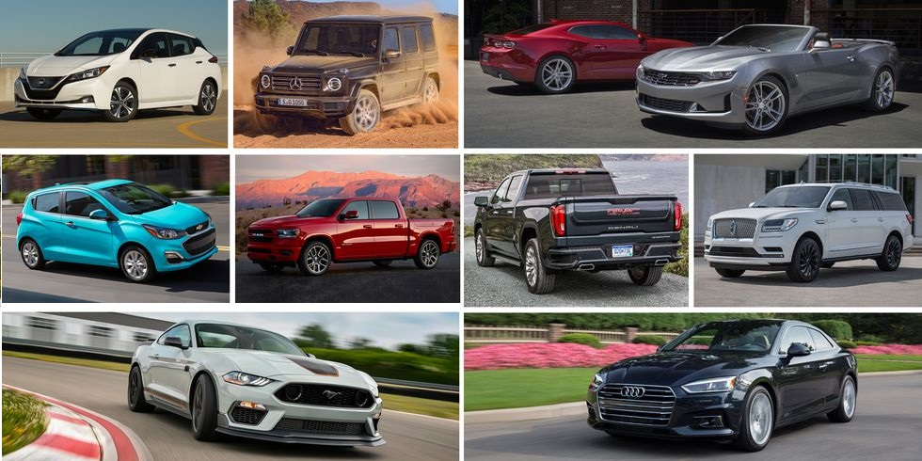
Used Car Pricing & Analysis
Scraping Car Data ● Predicting Prices ● Statistical Analysis
Team Members:
Amy Barba, Kiril Ivanov, Vaidehee Shah, J.D. Strode

Slide 2
About The Project
The idea of the project is to create a price prediction model for used cars in random cities across the US. As part of the project we did the following modules:
Data scraper for “Craigslist used cars ads”
Clean & explore the scraped data in Jupyter notebook with Pandas
Visualizations of the results and additional analysis on the data using Pandas and Tableau
Create a Machine Learning model to predict the price of used cars

Slide 3
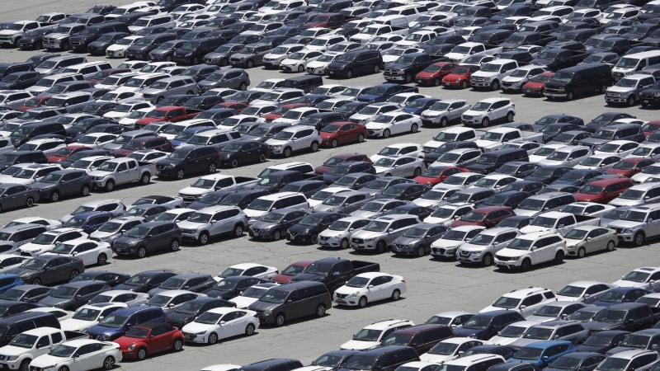
The Data
For the purpose of this project a dataset with Craigslist’s data was downloaded from Kaggle. After that the data was cleaned and prepared for the Machine Learning model and also for the data visualizations and analysis.
https://www.kaggle.com/austinreese/craigslist-carstrucks-data

Slide 4
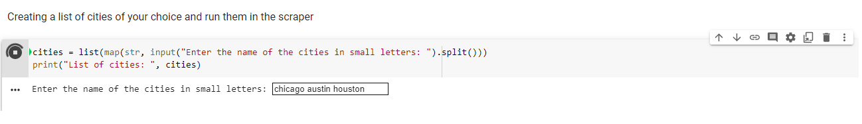
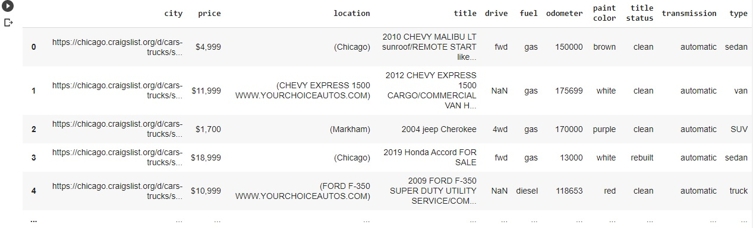
Scraper
For future reference a data scraper was built as well. The scraper gives the opportunity for the user to add personally any city or multiple cities in the US that would like to scrape used cars data for from Craigslist.
Then scraped data is pulled in a dataframe:
After that all the data is saved in a .CSV format and would be ready to be cleaned and fed to the Machine Learning model.

Slide 5
Cleaning & Exploring the Data
We started with 426,880 rows of data x 26 columns
Decided to filter by states first, choosing California, Illinois, New York, and Texas
In looking at the data we saw some significant outliers and we chose to filter those out as well. Choosing to only keep cars between the price range of $750-$100,000 and also cars with mileage between 1,000-300,000
There were several null values in our data set, in order to fill in those nulls we made some assumptions. For example if the year of the car was greater than 2019 we assumed the condition to be “new”
We used a function called ffill to fill in the rest of our nulls
In the end we were left with a dataset of 83,977 rows x 11 columns
Reduced variables down to…. year, manufacturer, conditions, cylinders, odometer, transmission, drive, size, type, state

Slide 6
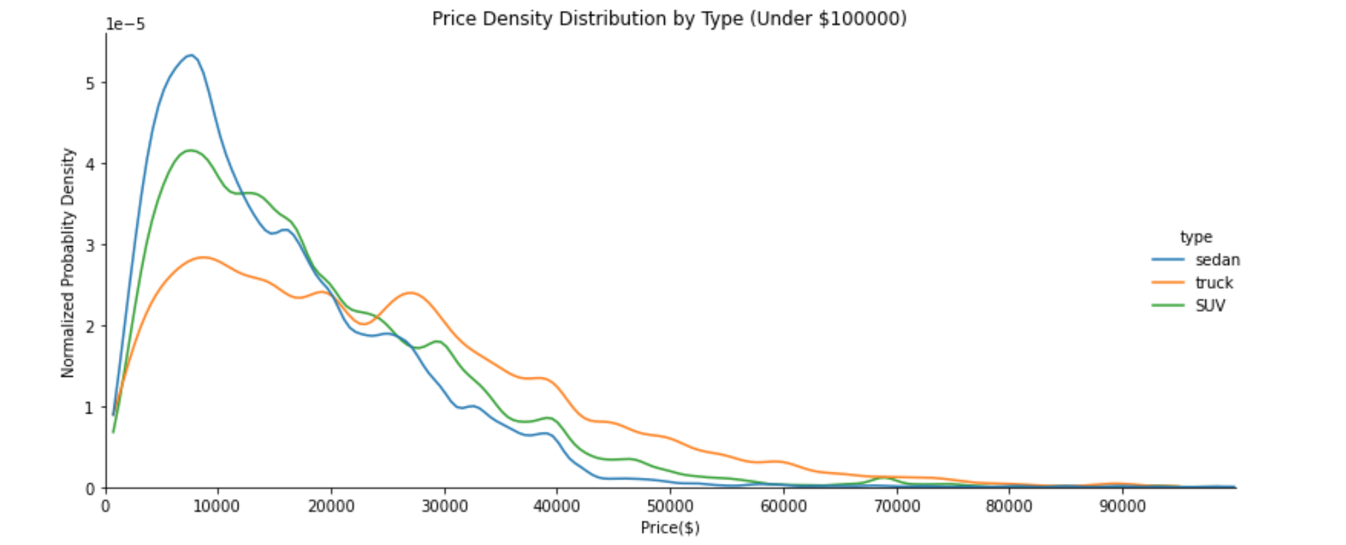
Visualizations of the Data: EDA
Examination of the price trend - price density distribution curve

Slide 7
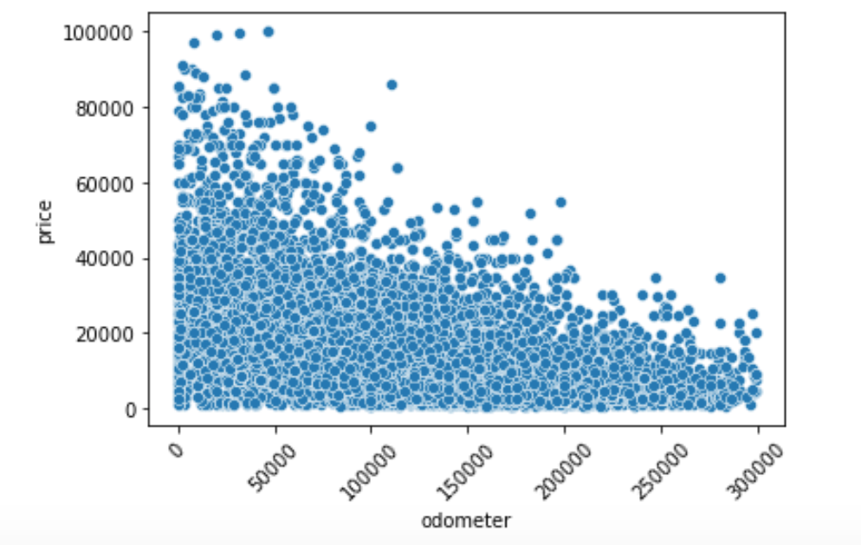
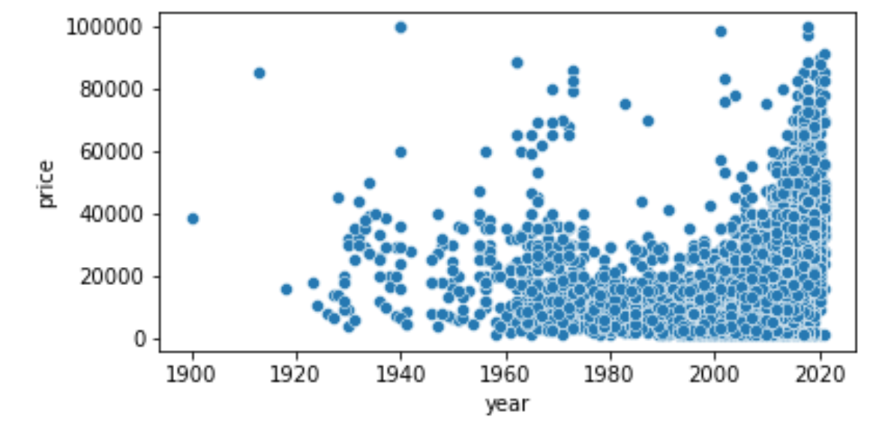
Visualizations of the Data: EDA cont.
Relation between odometer and price
Relation between year and price
Pricing of the most popular vehicles

Slide 8
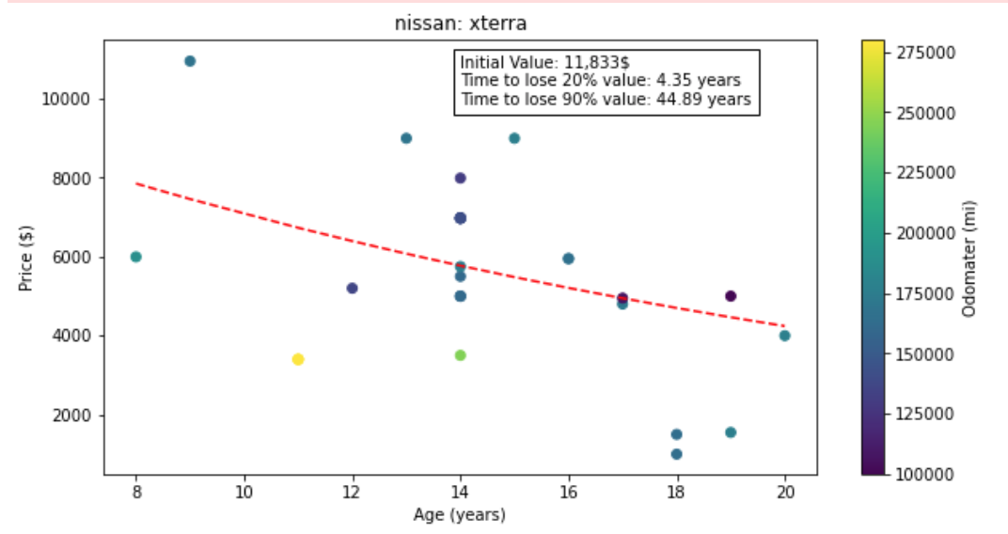
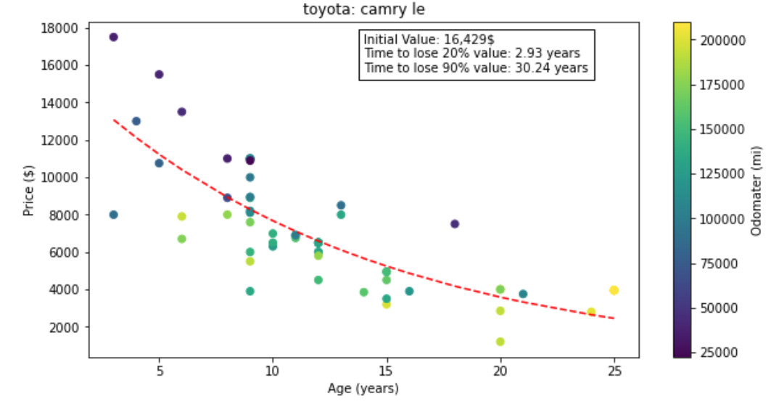
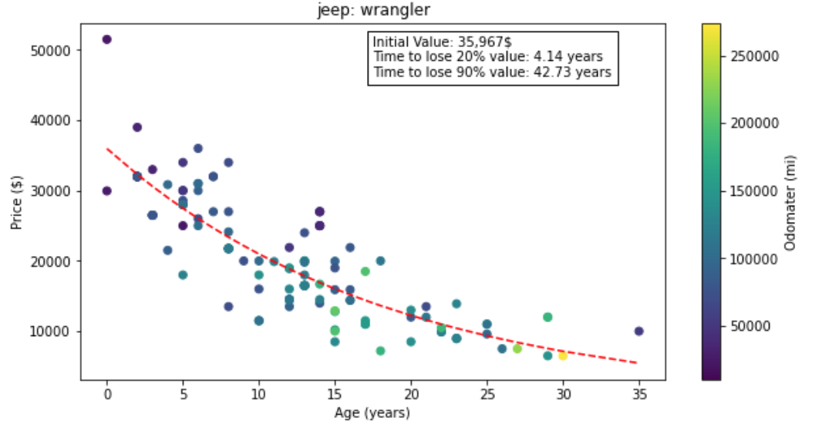
Depreciation Analysis

Slide 9
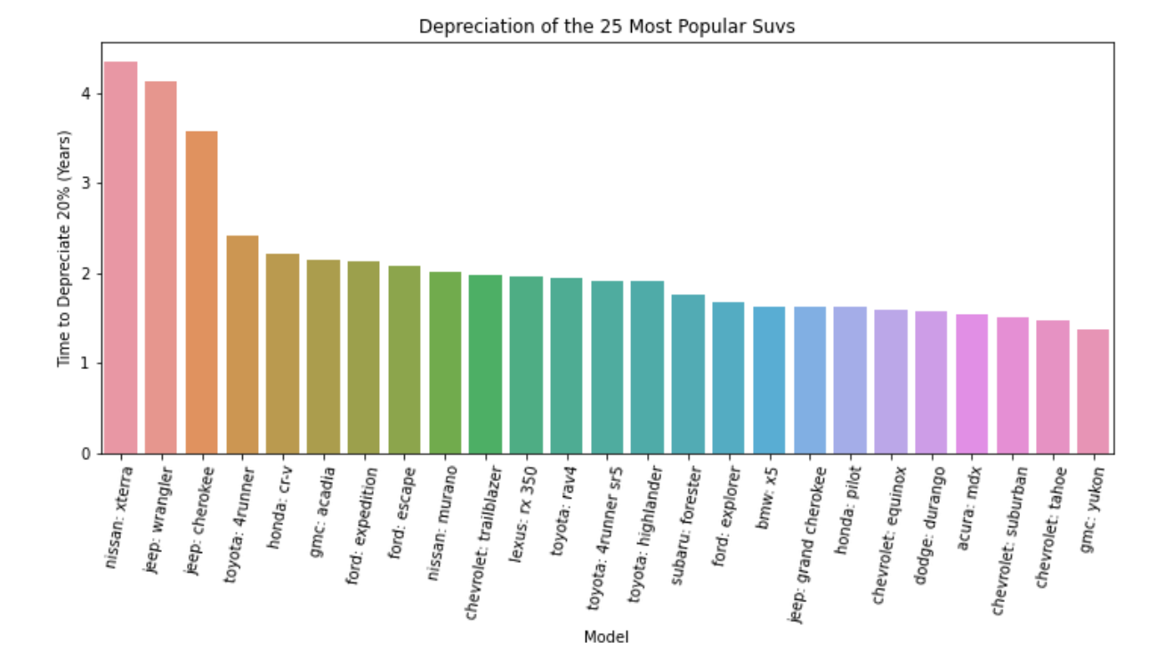
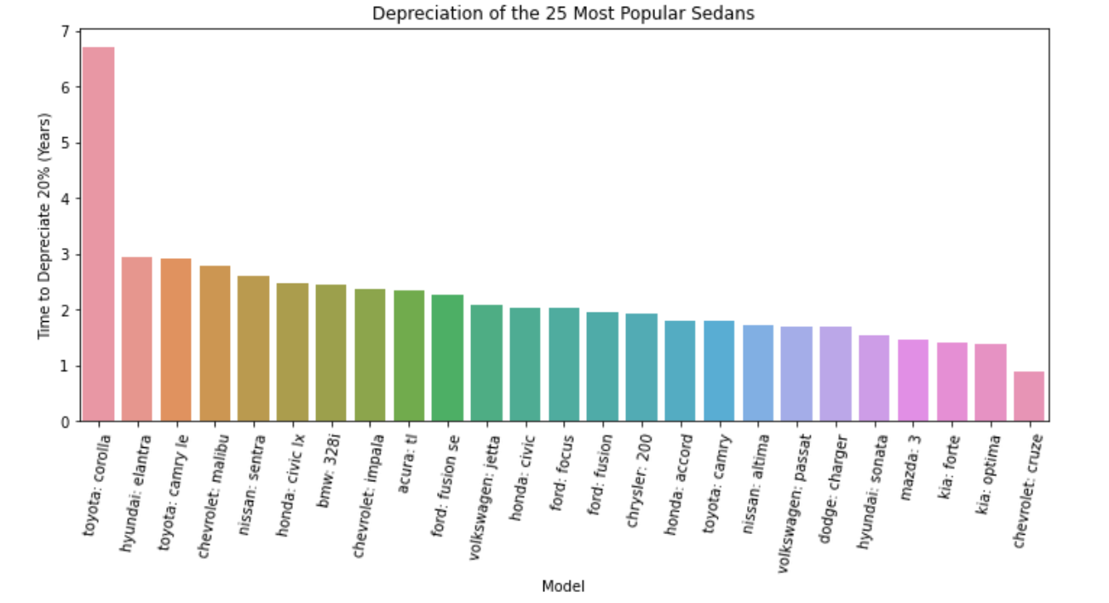
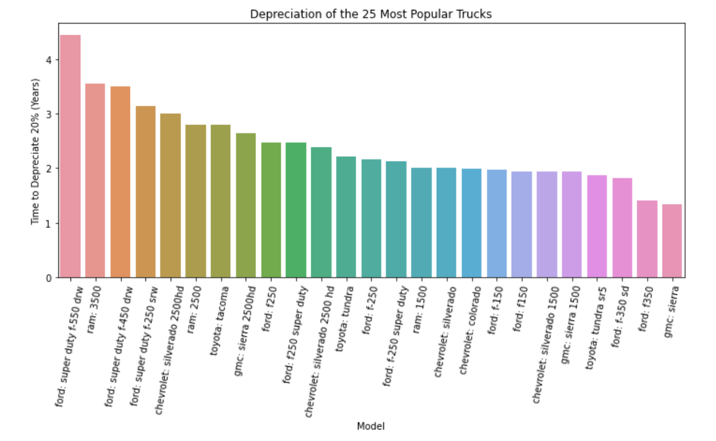
Depreciation Cont.

Slide 10
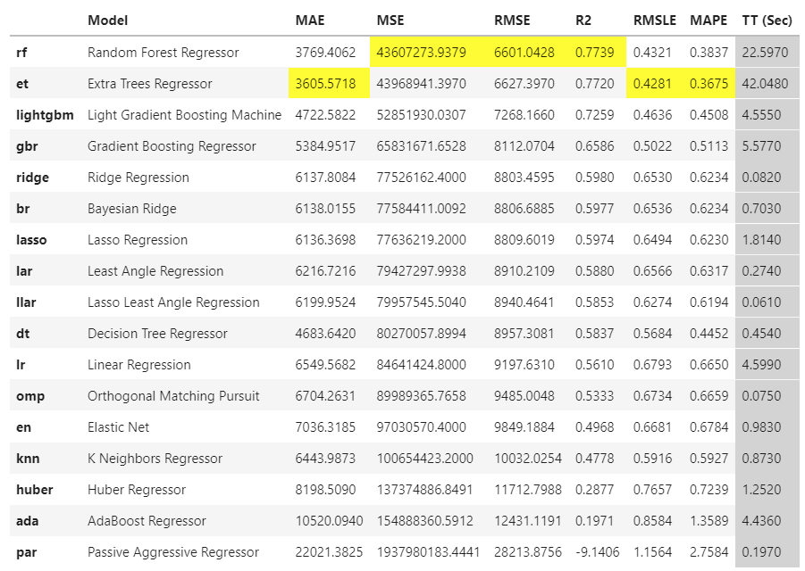
Developing a Machine Learning Model
Which model performs the best?
We used Pycaret Library to determine just this. (https://pycaret.org/)
Answer: Random Trees
R2 = .77
MAE = $3,769.41
Note: Pycaret’s <setup()> will also perform label encoding (categorical data), split it into Train & Test datasets, and perform any other necessary transformations on the data

Slide 11
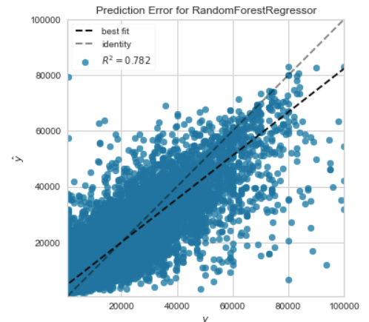
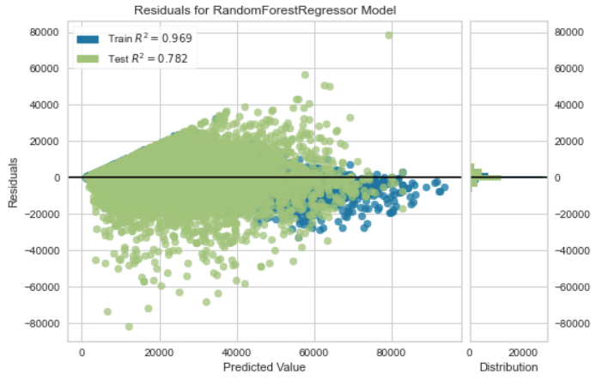
Developing a Machine Learning Model
Visualizing the Predicted Error & Residuals on Test Data

Slide 12
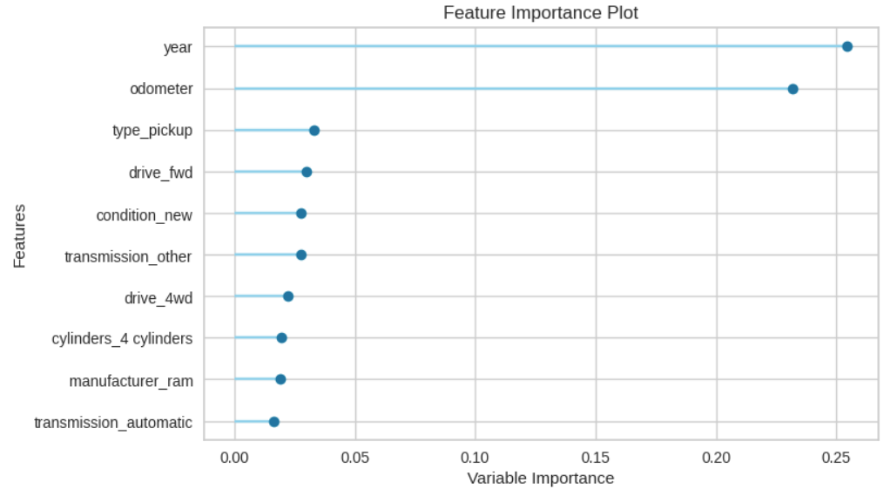
Developing a Machine Learning Model
What are the most important features and how does the model weight them?

Slide 13

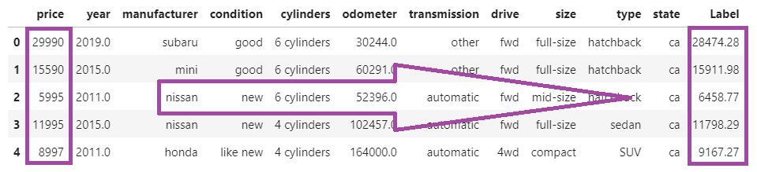
Developing a Machine Learning Model
How does the model perform on the full dataset?
How about on randomly withheld data?

Slide 14
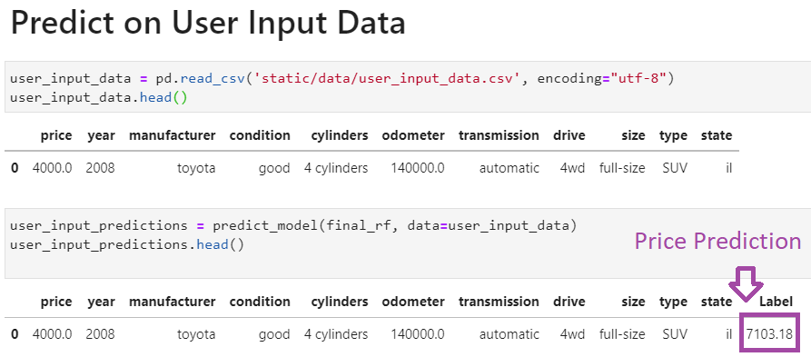
Developing a Machine Learning Model
Finally, let’s try using some user inputted data to predict the price of vehicle.

Slide 15
Takeaways & Other Considerations
Ways to improve our model:
Tuning the model using Pycaret
Formatting and cleaning our dataset differently
Developing a user interface for inputting the vehicle information to predict
A Flask application could be built for better user interaction
Will introduced us to a new library called “Streamlit” - you can build a beautiful apps very quickly with way less code without “flask”, “beautiful soup” and “html”
Gather more time series data to visualize car prices over time

Slide 16
Thank you

